Slide 1


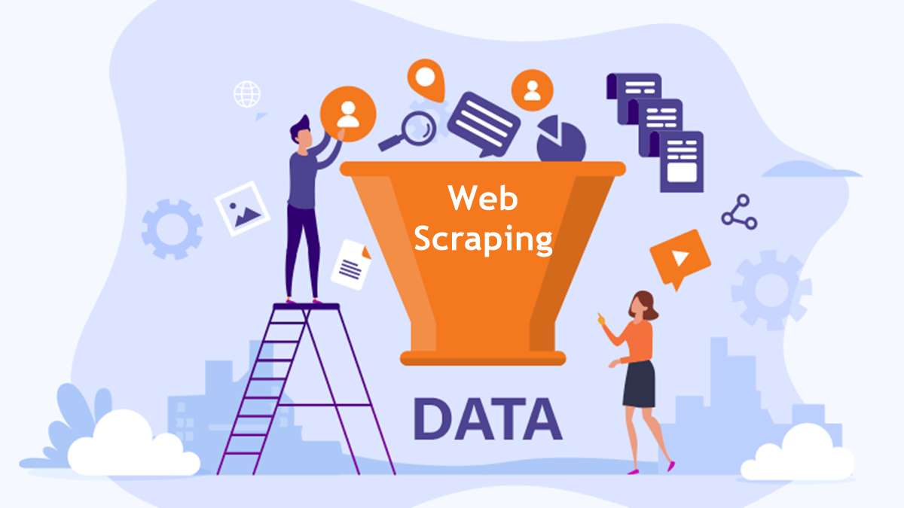
Project Show
Project Title: Leads Generate AI Agent
Course Title : Data Mining Lab
Course Code : CSE-436
Section : 212-D2
Presented By:
Md. Hasibur Rahman (212902018)
Md. Sajjad Hossen (212902032)
Department of CSE
Green University of Bangladesh
Presented To:
Md. Atikuzzaman
Lecturer
Department of CSE
Green University of Bangladesh

Slide 2
Table of Contents
01
Introduction
06
UI/UX
02
Problem Statement
07
Output
03
Objectives
08
Limitations and Future Works
04
Tools and Technologies
Conclusion
09
05
Dataset

Slide 3



Introduction
1
Introduction to DeepSeek Crawler
Aims to develop a Lead generative ai Agent.
To use-driven and LLM-powered and Groq API
2
3

Slide 4


Problem Statement
Non-technical user often lack tools to dynamically select the data they want and extract data from modern, dynamic website
Lead Generative Ai Agent Manual lead collection from website is time-consuming, error-prone, not scalable for large datasets
Traditional web scrapers are depend on fixed html structures , break frequently when websites change.
The solution shoud automote the process of web scraping, lead extraction and CSV generation

Slide 5
Objectives
To develop a user-friendly system to scrape venue data dynamically.
To enable non-technical users to extract custom fields for website data(name,location,price) etc.
To utilize LLM to understand content structure and extract data intelligently.
To export collected data to CSV for future use include machine learning model trainning purpose.

Slide 6
Tools and Technologies
Tool | Purpose
Python | Backend scripting
Flask | Web interface
Crawl4Ai | Asynchronous scraping engine
LLM (DeekSeek LLaMA) | Semantic data extraction
HTML/CSS/JS | Frontend UI
Pydantic | Data modeling
CSV | Output format

Slide 7
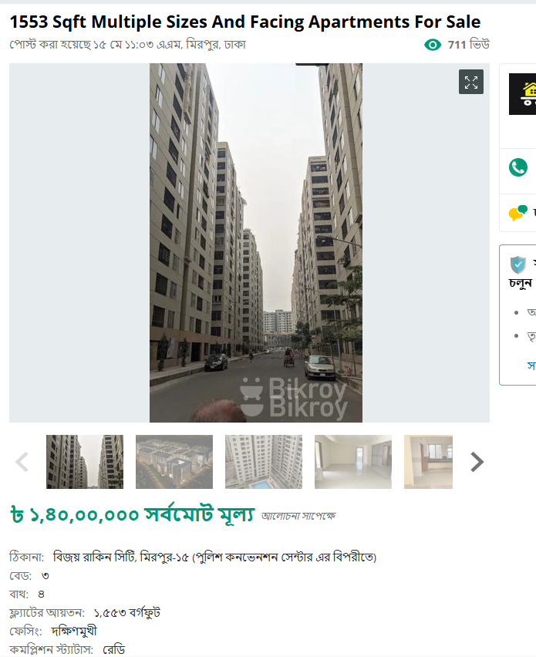
Dataset
No Static Dataset Used
Live Data Fetched From web-browser.
Custom Field are user-defined at Runtime
Sample fields include(name, location, price, rating, description)
Bikroy.com

Slide 8
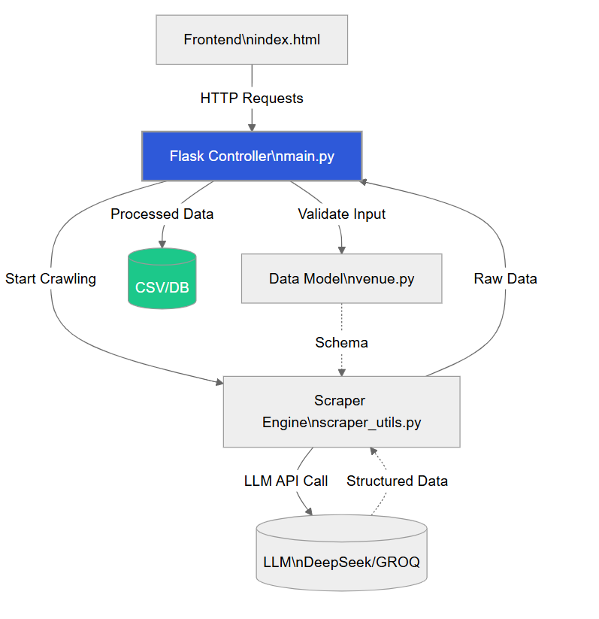
WorkFlow Diagram
Fig: Work Flow Diagram

Slide 9
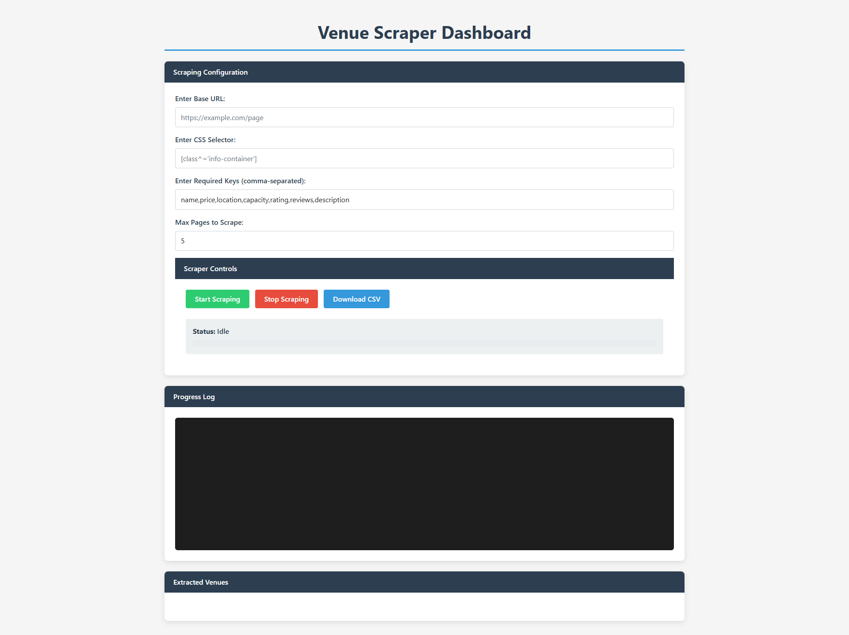
UI/UX
Figure-1: Simple Design for Leads Generate AI Agent

Slide 10
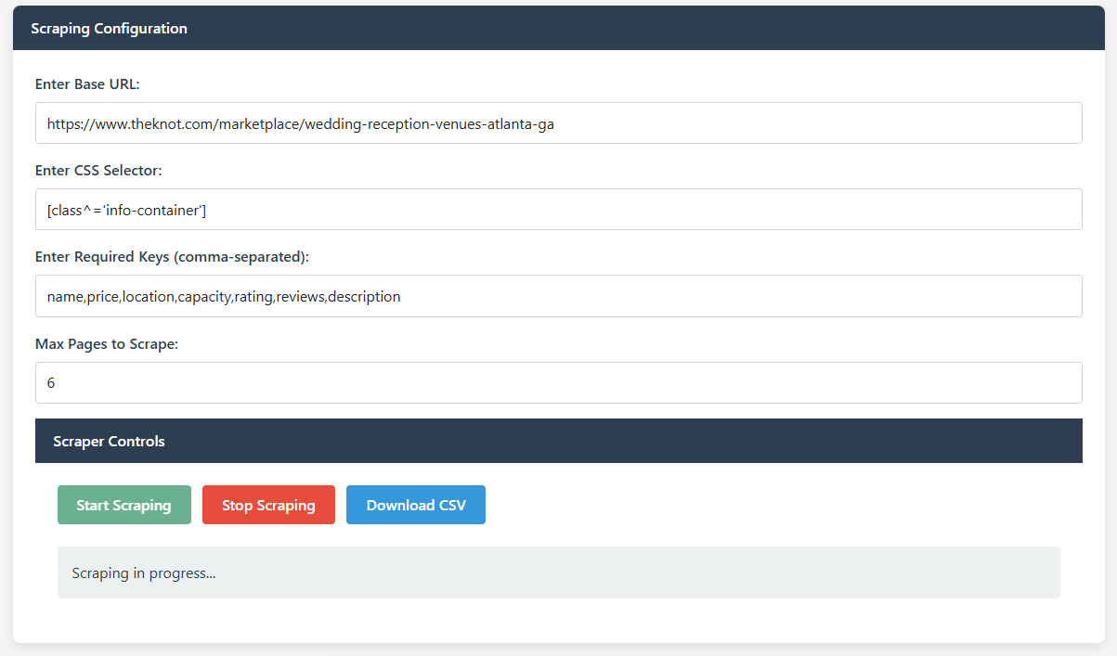
Output
Figure-2: Scraping Configuration (BASE_URL<CSS SELECTOR<REQUIRERD KEY<PAGES)

Slide 11
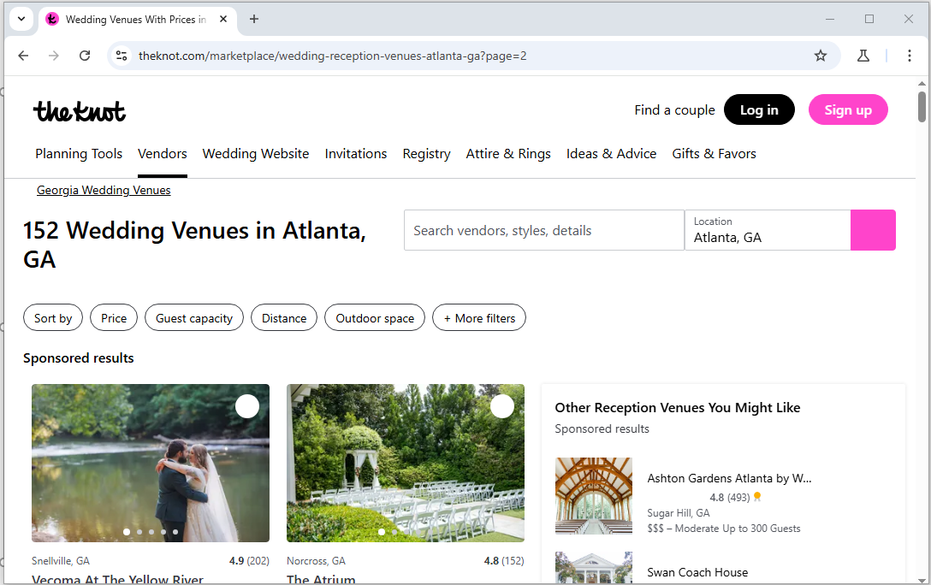
Output
Figure-3,4: Popup Website run for Scraping

Slide 12
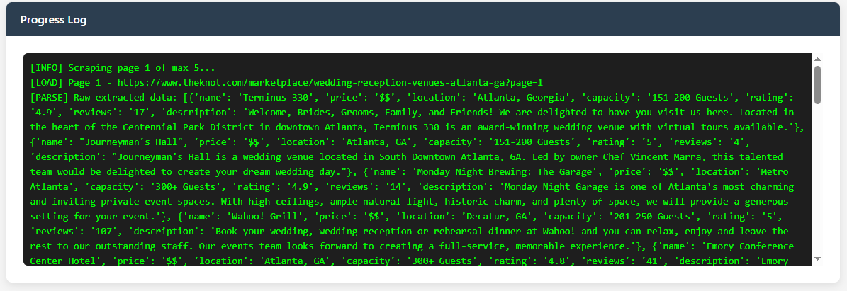
Output
Figure-5,6: Progress Log Bar Where Data and count showes

Slide 13
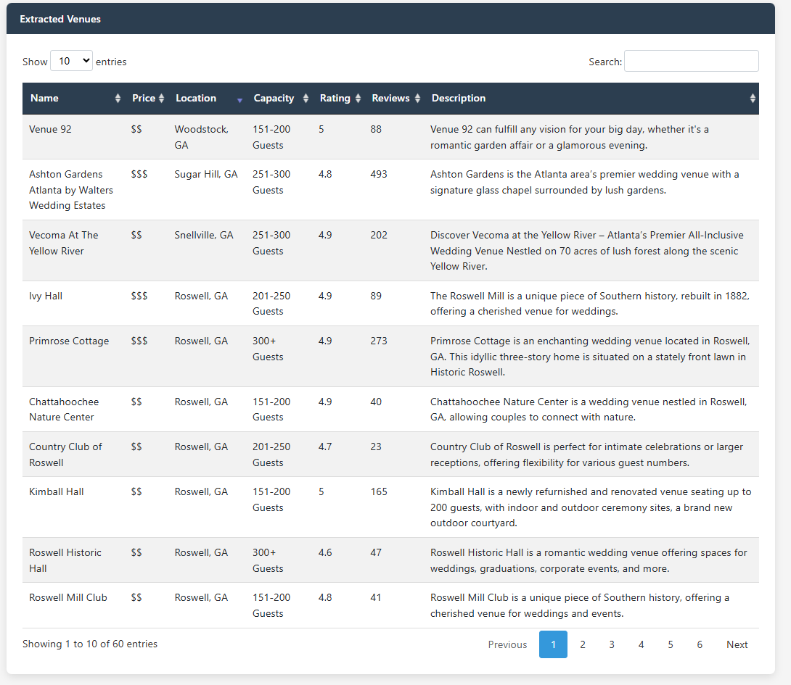
Output
Figure-7,8: Data Table After extraction from web-browser

Slide 14
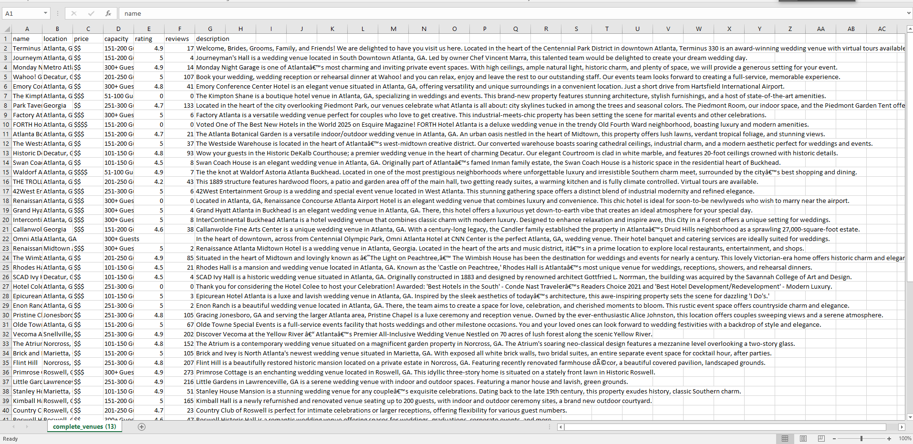
Output
Figure-9,10,11: final viwes after download as a CSV formate

Slide 15
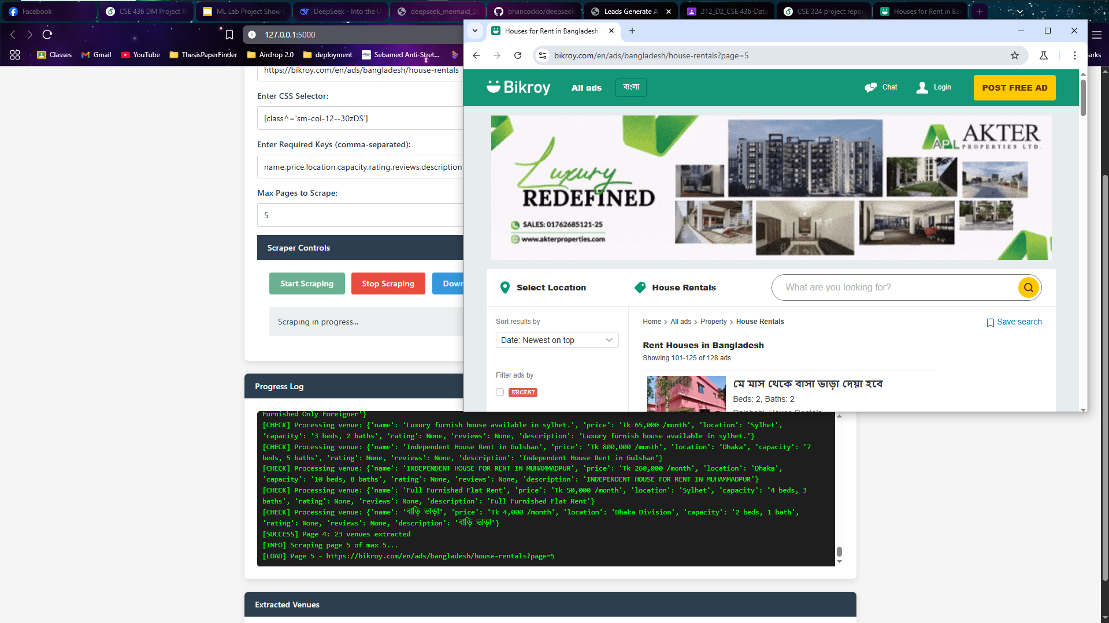
Output
Figure-12: Data scrping from Bikroy.com

Slide 16
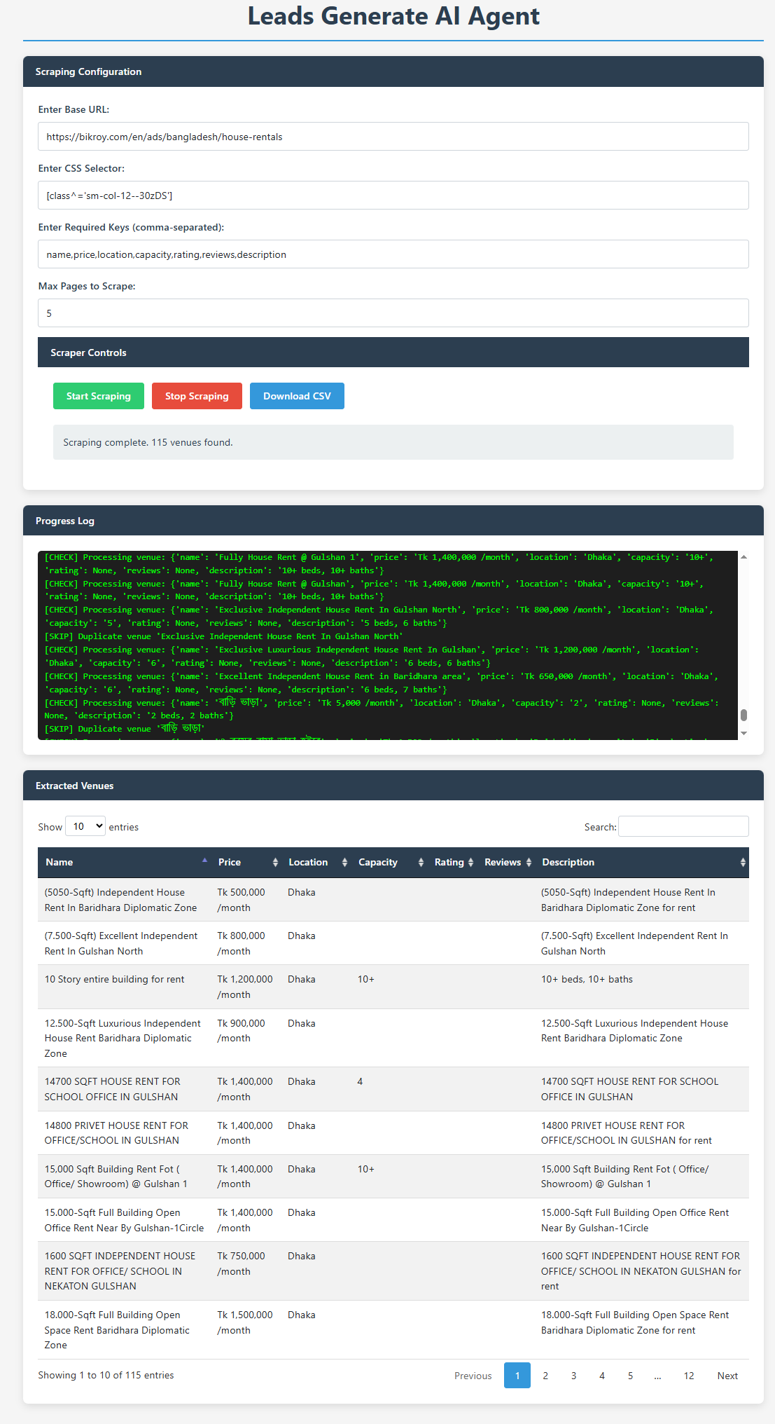
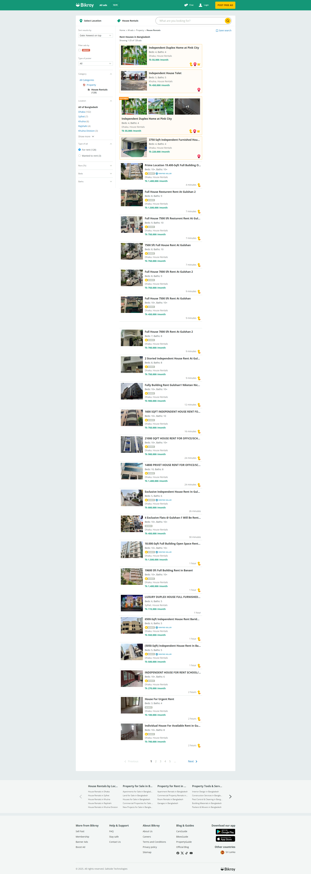
Output
Ai Agent Start Scraper
Automated Data extract from bikroy.com website
Figure-13: Data scrping from Bikroy.com

Slide 17
Limitations and Future Works
Limitations
Future Work
Depends on website structure consistency
LLM cost/API quota
No persistent storage (currently in-memory)
Add databse (Sqlite/PostgreSQL) support.
Add authentication + user history
Deploy on cloud (Docker + Azure/Render)
Add smart field suggestion using HTML auto-detection
Improve error handling + scraping robustness

Slide 18
Conclusion
Deep Seek Crawler is a modular, intelligent , and beginner-friendly solution
Dynamically adapts to any website structure using LLM
Bridges to gap between low-code users and powerful scraping.

Slide 19


